Slide 1




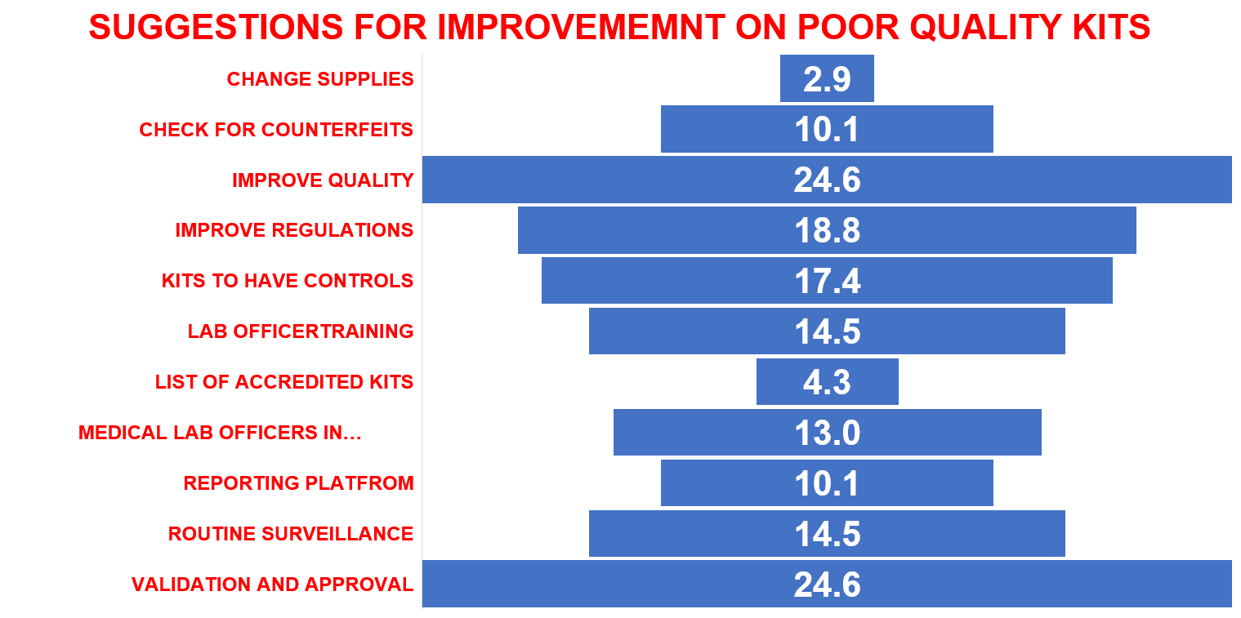
Poor Quality Diagnostics A Threat To National Health Security
Aggrey keya¹ , Kevin Oriki¹
1: Department of Health, Kajiado County
BACKGROUND
Poor-quality medicines in resource-limited settings are well documented, yet limited evidence exists on the quality of medical devices (MDs) and in-vitro diagnostics (IVDs). Field observations suggest similar quality concerns, but scientific reporting remains scarce
OBJECTIVE:
This study assessed laboratory officers’ knowledge of pharmacovigilance and the quality of routine in-vitro diagnostic test kits in Kenya
METHODOLOGY
A cross-sectional study was conducted among laboratory professionals working in public ,private, and faith-based facilities in Kenya.
STUDY AREA: Fourty seven Counties, Kenya
STUDY DESIGN AND SAMPLING
A cross-sectional study was conducted among laboratory professionals working in public ,private, and faith-based facilities in Kenya. Data was collected using a structured, self-administered online questionnaire distributed via WhatsApp between April 23 and May 19, 2025.
STATISTICAL ANALYSIS:
The responses were downloaded as an excel sheet from the google forms and checked for completeness
Data was loaded to SPSS Statistics version 20.0 (IBM SPSS Statistics) for analysis applying descriptive statistics to determine frequencies and proportions whereas qualitative data using NVivo version 15 for thematic analysis..
RESULTS
A total of 99 laboratory officers from 30 counties participated: 69.7% from public facilities, 24.2% from private, and 6.1% from faith-based institutions. 69.7% males and 30.3% females responded, with a majority 32% having worked for less than 5 years.
DISCUSSION
Poor-quality diagnostic test kits are present in Kenya, yet underreporting persists largely due to limited awareness of formal reporting systems such as PvERs. Unreliable diagnostic kits threaten patient safety, contribute to mismanagement of infectious diseases, promote antimicrobial resistance, and undermine disease surveillance and overall national health security.
*
CONCLUSIONS
Training laboratory officers on pharmacovigilance, enforcing regulatory oversight to ensure use of approved diagnostic kits, and establishing a national diagnostic policy with clear implementation mechanisms are critical steps towards improving diagnostic quality
Contact: aggreykeya@ymail.com
CO-AUTHOR 1 INSTITUTIONAL

